Slide 1
Subqueries with the in Operator
CMPE 2400
Databases

Slide 2
Subqueries
A subquery is a query that is nested within a parent query.
  The key to writing a proper subquery is to remember what is expected by the parent query in the spot in which the subquery is placed.
    For example, if a subquery is to be included in a select list, the subquery must produce exactly one result, or the parent query will cease up.
    Also make sure to remember that data types can also be mismatched even if the number of records returned by the subquery is acceptable.

Slide 3
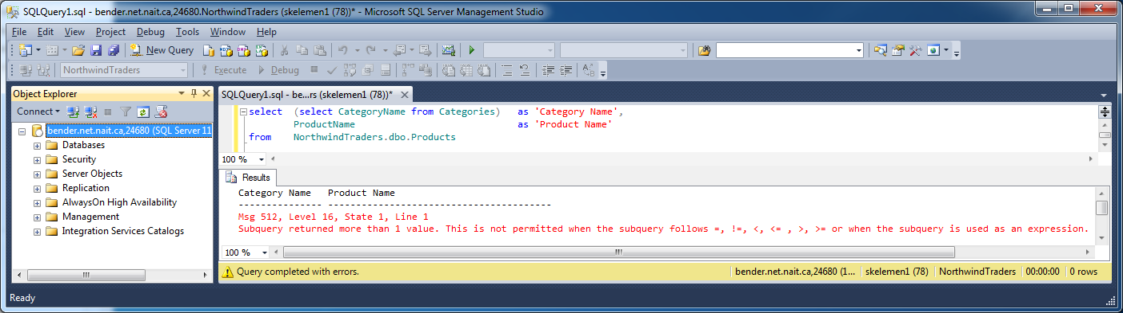
Subqueries
Busted on number of records mismatch.

Slide 4
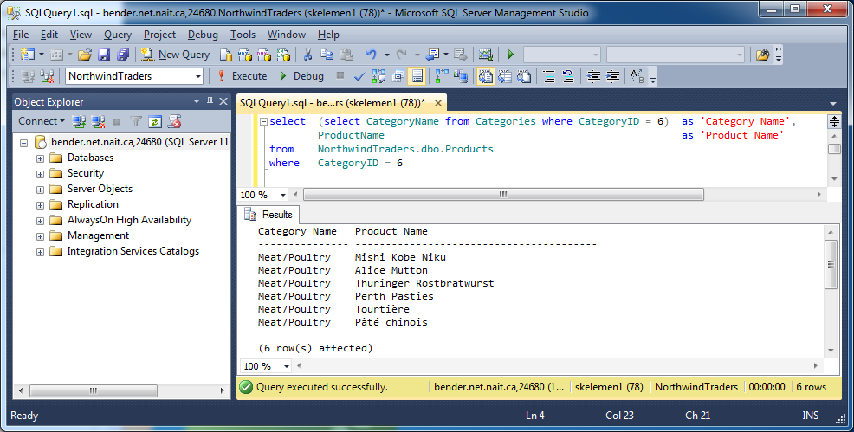
Subqueries
This one is contrived but at least it works…

Slide 5
Filtering with Subqueries
Using a subquery is one way in which two entities in the database may interact.
  The results of a query which interrogates one entity, or table, may be used to filter the results obtained by querying a second entity from which we are actually interested in retrieving information.

Slide 6
Filtering using in Subqueries
The in operator is often used to create the subquery bridge between entities.
  Recall that the in operator is used when creating filters, using the where clause, that compare a set of discrete values to a column or calculation.
  A subquery returns a set of discrete values just like any other select statement.
    Because the values retrieved by the subquery are discrete, the in operator is quite happy to use the returned results to filter the rows returned from the parent select statement.

Slide 7
Filtering using in Subqueries
As the in operator works upon a LIST of values, not a multiple columned table of values, only one column may be chosen by the subquery to form that list.
  Additionally, it is good practice to ensure that there are no duplicates within the list returned by the subquery, as duplicates will cause many unneeded comparisons, thus decreasing the efficiency of the query.

Slide 8
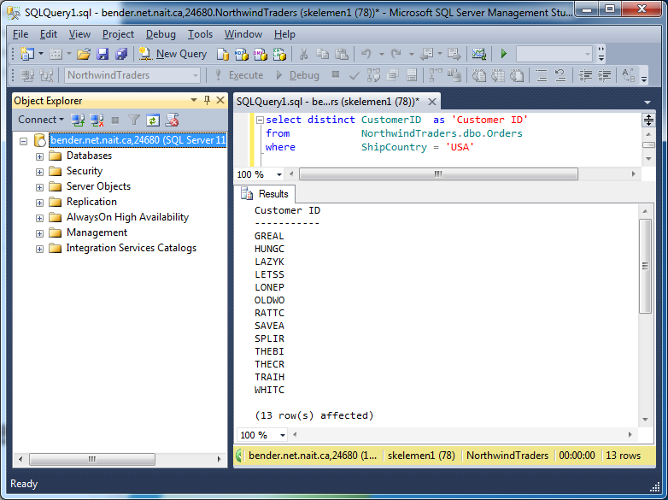
Filtering using in Subqueries
Suppose that you need a list of company names that have a shipping address within the USA.
  First, a unique list of customers linked to orders shipped to the USA must be identified.

Slide 9
Filtering using in Subqueries
The Company Name is stored in the customer table, so we may use the in operator, and embed the previous as a subquery.
  Note that, quite conveniently, the CustomerID provides a link between the two tables.
  Also, column aliasing will only be required on the outermost query.

Slide 10
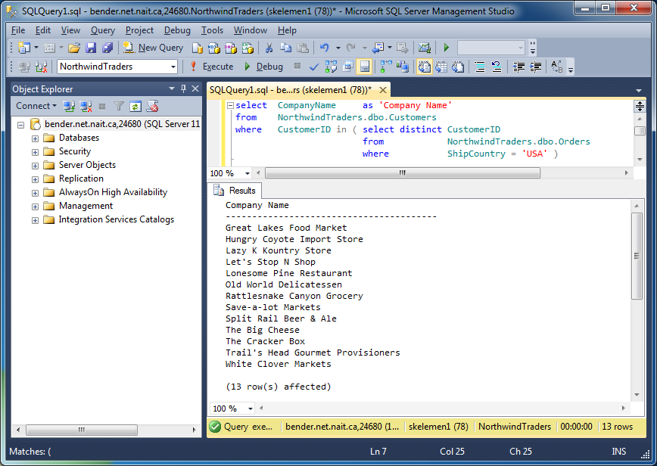
Filtering using in Subqueries
Voila! Company names for orders shipped to the USA.

Slide 11
Filtering using in Subqueries
Just to show a glimpse of the possibilities, realize:
  Double nesting, or more, is perfectly legal.
  Negative logic works nicely.
  Combinational logic will still work just fine.
    Remember that the in operator is merely a comparison operator in the where clause.
    Make a list of meat products that have never been sold
  to the company with the CustomerID ALFKI

Slide 12
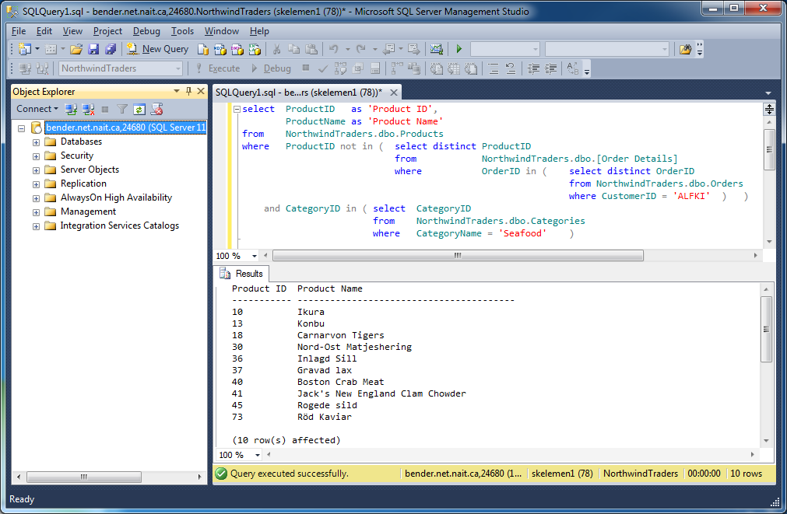
Filtering using in Subqueries
Retrieve a list of seafood products that have never been sold to the company with a customer ID of ALFKI.

